Slide 1
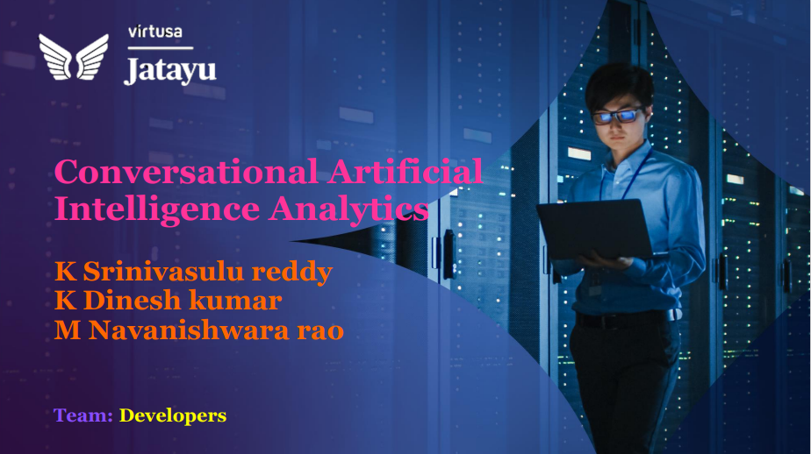

virtusa

Slide 2
virtusa
Business Need/ Opportunity
Identification of Business Problem
Implementing AI INTO BUSINESS environments to improve the employe productivity and enhancse the overall customer experience.
Implementing in AI it also helps to avoid mistakes and detect potential crises.
To save time and money by automating and optimising routine processes and tasks.

Slide 3
virtusa
Business Problem/Need/Opportunity
Need Assessment
Applicaton based Programming in python.
Artificial neural networks.
Classic search and planning.
Deep learning.
Dedign and Analysis of Algorithm.
Digital image processing.
Statastical learning method.
Brain simulation.

Slide 4
virtusa
Market Potential
AI is important because it forms the very foundation of computer learning.
Through AI computers have ability to harness massive amount of data and use their learned intelligence.
The global artificial intelligence market size was estimated in 2022 was $1119.78 billion.
The Ai was excepted to hit 2030 by 1,597.1 billion

Slide 5
virtusa
Target Segment/Market Size
AI in education system will change the role of teachers significantly.
AI market size was valued at USD 328.34 billion in 2021.
The market is projected to grow from USD 387 billion in 2022 USD 1,394 billion by 2029, exhibiting a CAGR of 20.1% during the forecast period.
It has massive and contionous upskilling of teachers significantly.

Slide 6
virtusa
Solution Details
Data Engineering Prepare your data to make the most of AI algorithms.
Data Science Uncover meaningful insights to improve your products or services.
Recommender Systems. ...
Natural Language Processing.
Computer Vision.
Audio Recognition.

Slide 7
virtusa
Future Readiness
Artificial Intelligence is shaping the future of humanity across nearly every industry/
It is already the main driver of emerging technologies like big data, robotics and IOT and it will continue to act as a technological innovator for the foresseable future.
Artificial Intelligence is employing machine learning and compute vision for detection and classification of various events.

Slide 8
virtusa
About the Team
TEAM Members
K Srinivasulu reddy
K Dinesh kumar
M Navanishwara rao

Slide 9
virtusa
Thank you

